Slide 1


Slide 1
Introduction to Data Linkage with
RADMILA VELICHKOVICH
Business Research Partner
Empowerment Through Knowledge
Supported by:
DATA SCIENCE CONFERENCE 5.0 SERBIA
and
DATA SCIENCE AND MARKETING ACADEMY, ETK
Belgrade, Serbia
16 November 2019

Slide 2
Table of content
LET'S GET TO KNOW
EACH OTHER
INTRODUCTION TO DATA LINKAGE
DATA MATCHING PROCESS
LITERATURE AND
RESOURCES
AVAILABLE TOOLS
QUESTIONS?

Slide 3
LET'S GET TO KNOW EACH OTHER

Slide 4




About me
2015-2018: MA Survey Methodology and Public Opinion
2016-2017: Institute for Marketing and Market Research
2017: Data analyst in media industry
2018-2019: R Instructor (freelance)
August 2019- present

Slide 5

Slide 2
ETK

Slide 6
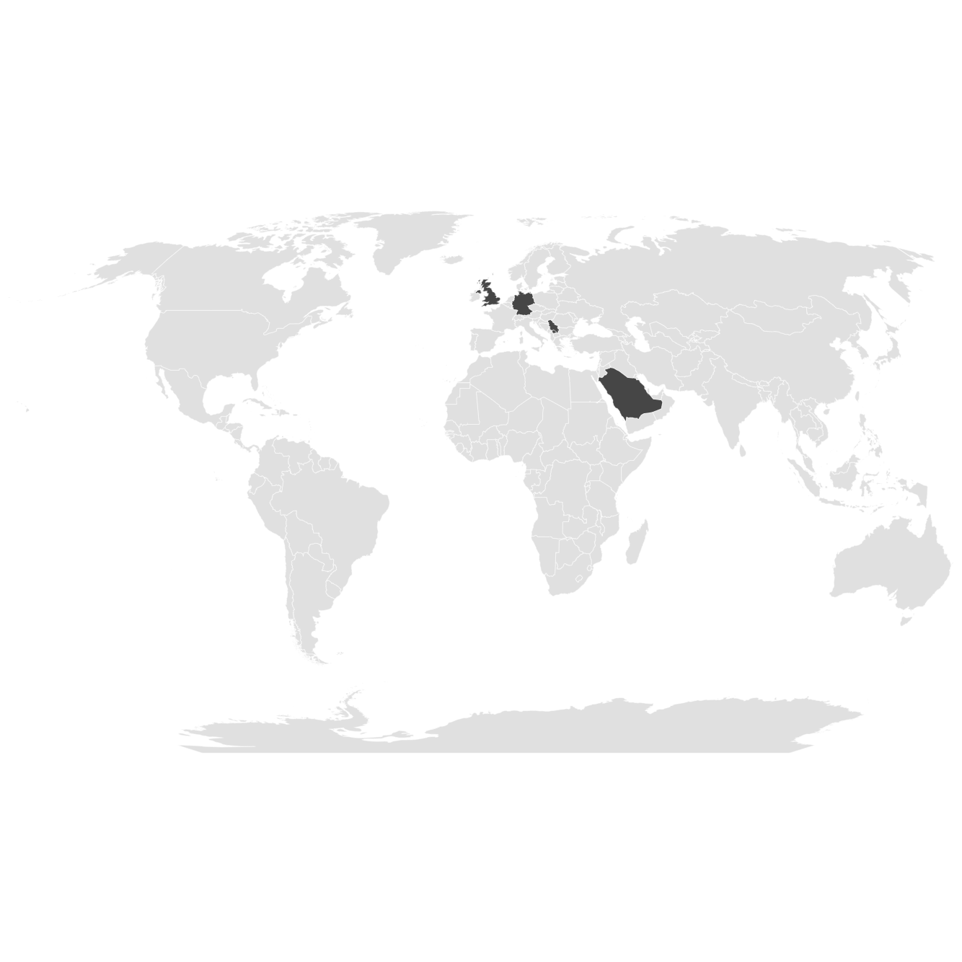
Slide 2
AT A GLANCE
ETK (Empowerment Through Knowledge) is a London based market research and data science consulting firm.
We have offices in London, GB (headquarters), Frankfurt, DE, Riyadh, SA and Belgrade, RS.
Our strength lies in both the highest professional standards and profound knowledge of the local market and its consumer.
Our dedicated team believes that our international experience combined with the deep knowledge of the local market and culture makes the competitive edge.
We demonstrate and set high expectations for ourselves in providing clients with the exceptional service. ETK promotes a culture of professionalism by leading by example.

Slide 7
Introduction to Data Linkage

Slide 8
Introduction to Data Linkage Definition
Data linkage is the task of identifying, matching, and merging records that correspond to the same entites (people, families, companies, product items, events etc.) from several databases or combination of different sources.
By matching we:
Avoiding new data collection by linking existing datasets (lower financial burden, lower burden for respondents, a potential solution for low response rate)
Are in position to perform additional analyses
Can obtain additional (less biased?) insights
Data linkage=record linkage= entity resolution=object identification=field matching

Slide 9
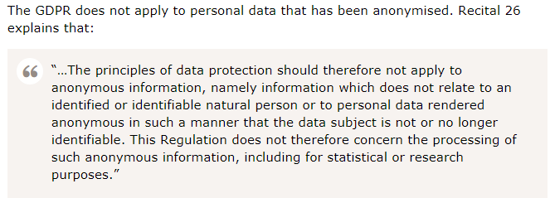
Introduction to Data Linkage My concerns were...
What if I didn't have unique ID at all?
What if the unique ID was unique to one dataset and differs from the ID in the other dataset ?
Is there a theory-implentation gap?
What is the data quality of linked dataset? What power do I gain as a researcher?
Privacy-preserving record linkage

Slide 10



Introduction to Data Linkage examples
Swiss Federal Statistical Office: (e.g Longitudinal linkage)
SwissRDL: medical Registries and Data Linkage
SORS: Challenge for 2021; Linking census and geospatial data
SILC (Survey on Income and Living Conditions): In France, households get less questions on their income when they allow INSEE to access their tax returns; linking administrative with survey data

Slide 11
Introduction to Data Linkage Typology
DETERMINISTIC- The simplest kind of record linkage, generates links based on unique identifier(s) that match among the available data sets or some other rule-based
PROBABILISTIC - takes a different approach to the record linkage problem by considering a wider range of potential identifiers and calculating the probability that two given records refer to the same entity. Record pairs with probabilities above a certain threshold are considered to be matches, while pairs with probabilities below another threshold are considered to be non-matches; pairs that fall between these two thresholds are considered to be "possible matches" and can be dealt with accordingly (e.g., human reviewed, linked, or not linked, depending on the requirements).
MACHINE LEARNING APPROACH- classification algorithms

Slide 12
Introduction to Data Linkage Challenges
Identifying duplicates
As the databases to be matched get larger, the computation complexity of data matching therefore grows
The true status of two records that are matched across two databases is not known
Privacy and confidentiality (privacy preserving data linkage)

Slide 13
Introduction to Data Linkage Challenges
Tables that contain the same type of information can have different names
Attributes coded/formatted differently (e.g. different date convention)
Compound information (e.g. Postcode and Location) in the same column
Attributes can be recorded in different measurements
Even if there is an ID it is differently named

Slide 14
DATA MATCHING PROCESS

Slide 15
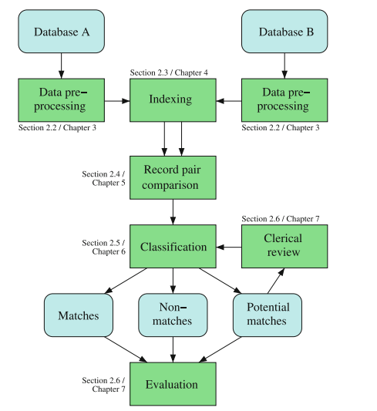
Data Matching Process
Source: Concepts and Techniques for Record Linkage, Entity Resolution, and Duplicate Detection Christen, Peter

Slide 16

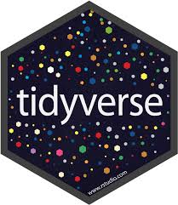
Data Matching Process How does fit?
RecordLinkage
PPRL
fastLink
StatMatch
Source: Concepts and Techniques for Record Linkage, Entity Resolution, and Duplicate Detection Christen, Peter

Slide 17
Data Matching Process Data pre-processing
Within one dataset
Missing values
Smoothing noisy values
Identifying and correcting inconsistencies

Slide 18
Data Matching Process Data pre-processing
For Data Matching
Removing unwanted characters and tokens (plus correct misspelling)
Segmenting attributes into well-defined and consistent output
Verifying attributes based on existing attributes

Slide 19
Data Matching Process Indexing
Record pair comparison process is computationally expensive even for small datasets.
This is because we need to compare one record with all the remaining ones.
This results to a total number of record pair comparisons that is quadratic in the size of the datasets to be matched. For example, matching 7x7=49 comparisons.
Clearly, this naïve comparison of all records does not scale to very large datasets. Matching two datasets with 1 000 000 records each results in 1 000 000 000 000 record pair comparison. This takes time (calculated in days).

Slide 20
Data Matching Process Indexing
To reduce the possibly very large number of pairs of records that need to be compared, indexing techniques are commonly applied. They generate candidate record pairs that will be compared in more details in the comparison step of the data matching process to calculate the detailed similarities between the records.
Various indexing techniques for data matching and deduplication have been developed (e.g. blocking). It splits dataset into smaller blocks according to some blocking criteria (blocking keys).

Slide 21
Data Matching Process Record pair comparison
Comparing record pairs with and without indexing.
However, data used in the matching process can be of low quality (errors, typographical variations, names and address values can change over time)
Even sophisticated data cleaning and standardisation techniques are not always able to create high quality data that will convert values into the same form for all attributes in pair of records that refer to true matches.
Rather than comparing attribute values between two records using only an exact comparison function, it is vital for data matching to employ comparison functions that return some indication of how similar two attribute values are.
There exists various similarity measures (q-gram based string comparison, Jaro and Winkler, Extended Jaccard Comparison).

Slide 22
Data Matching Process Classification
Deciding on matching status (match/ non-match/ possible match)
Classification as a result of determistic/probabilistic/or ML methods

Slide 23
Data Matching Process Evaluation
True positive - These are record pairs that have been classified as matches and that are true matches. These are the pairs where both records refer to the same entities.
False positive - These are the records that have been classifed as matches, but they are not true matches. The two records in these pairs refer to two different entities. The classifier has made a wrong decision with these record pairs.
True negative - These are the record pairs that have been classified as non-matches, and they are true non-matches. The two records in pairs refer to two different real-world entities.
False negative - These are the record pairs that have been classified as non-matches, but they are true matches.

Slide 24
AVAILABLE TOOLS

Slide 25
Available tools
R
Various packages available
Python
Python Record Linkage Toolkit
OTHER

Slide 26
Other tools
BigMatch
Developed and by the US Census Bureau to match very large census data collections
It is not a full data matching system, rather it is a programme that can be used to extract potential matches from very large files. These plausible matches are saved into smaller files so that they can be individually processed with a proper data matching system later on.

Slide 27
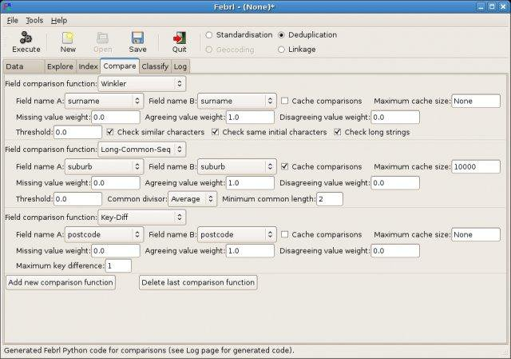
Other tools
FEBRL
The Freely Extensible Biomedical Record Linkage system is an open source data matching system that has been developed since 2003 at the Australian National University.
The aim was to improve pre-processing, deduplication and data matching.
Written in Python

Slide 28
Literature and resources
Books:
Concepts and Techniques for Record Linkage, Entity Resolution, and Duplicate Detection, Peter Christen, 2012, Springer
Data Quality and Record Linkage Techniques, Herzog et al, 2007, Springer
Methodological Developments in Data Linkage, Harron e al., 2015, Wiley
PPRL R package: https://cran.r-project.org/web/packages/PPRL/PPRL.pdf
fastLink R package: https://cran.r-project.org/web/packages/fastLink/fastLink.pdf
Record Linkage R package: https://cran.r-project.org/web/packages/RecordLinkage/RecordLinkage.pdf
Privacy Preserving Record Linkage Workshop: https://sites.google.com/view/pprl2019workshop/

